Slide 1
Professional Development
Presented by the Chapter Resource Team
Kara Brostron, CLM and Patti Winter, CLM, PHR, SHRM-CP
Tuesday, February 11 at 9AM PST

Slide 2
Roundtable Questions
What is one of the best FREE programs your chapter has offered (in the last year)?
Who is one of the best PAID speakers you hosted (in the last year)?
What is your chapters best educational offering?

Slide 3
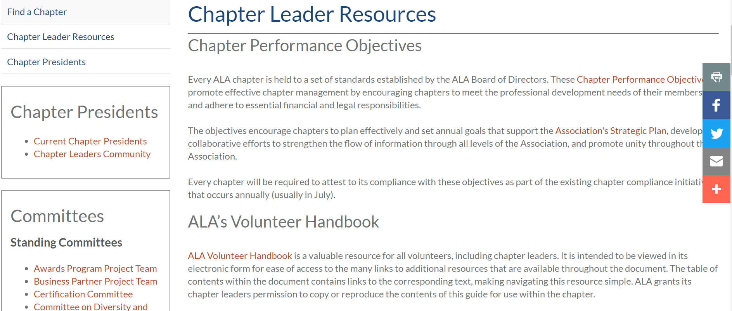
ALA’s Volunteer Handbook
Notes:
ALA Volunteer Handbook - https://www.alanet.org/docs/default-source/volunteer-resources/ala-volunteer-handbook---06-26-201950bd3993272c6b268d51ff000093711e.pdf?sfvrsn=929152ab_0

Slide 4
Chapter Leadership Resources
https://www.alanet.org/membership/chapters/chapter-leader-resources/chapter-education
Notes:
Chapter Leadership Resources – Education
https://www.alanet.org/membership/chapters/chapter-leader-resources/chapter-education

Slide 5
Chapter Leader Resources/Education
Chapter Education Toolkit
Guides for Education Chairs
Chapter Education Checklist
Identifying Topics, Speakers & Programs
Chapter Education Database aka Speaker Database
Education Evaluation
Individual Session Evaluation Form
Chapter Education Summary Form
This form is used to compile the Education Database
Notes:
Guides for Education Chairs - https://www.alanet.org/docs/default-source/chapter-resources/chapter-education---a-guide-for-ed-chairs-and-presidentsdf203993272c6b268d51ff000093711e.pdf?sfvrsn=10c52ab_0
Chapter Education Checklist – https://www.alanet.org/docs/default-source/chapter-resources/chapter-education-chair-checklist4a213993272c6b268d51ff000093711e.pdf?sfvrsn=9d0d52ab_0
Chapter Education Database - https://my.alanet.org/chapter-education-database/chapteradmin/
Individual Session Evaluation Form - https://www.alanet.org/docs/default-source/chapter-resources/individual-session-evaluation-form.pdf?sfvrsn=920c52ab_0
Chapter Education Summary Form - https://www.alanet.org/docs/default-source/chapter-resources/chapter-education-summary-form---october-2017.pdf?sfvrsn=e77b46ab_0

Slide 6
Types of Professional Development
Briefings ▪ Panel Discussions
Training ▪ Office Tours
Presentations ▪ Seminars
BOLD Bites ▪ Business Partner (Business of Law Discussions) Seminars
Podcasts or Video Clips
Idea Exchanges

Slide 7
Cover all KSAs (Knowledge, Skills & Abilities)
Communications & Organization Management (CM)
Financial Management (FM)
Human Resource Management (HR)
Legal Industry/Business Management (LI) (includes marketing and planning techniques)
Operations Management (OM) (includes technology)
Notes:
Enter the data from the Summary Report into the Chapter Education Database aka “Speaker Database” to share with other chapters.

Slide 8
Where to Find Education
Strategic Alliance Partners (ILTA, LMA, etc.)
ALA Monthly Webinars
ALA National Committees
ALA Chapter Resource Team (CRT)
Collaborate with another chapter
(chapters@alanet.org - headquarters)
(chlead@commlist.alanet.org – online community)
Chapter Education Database

Slide 9
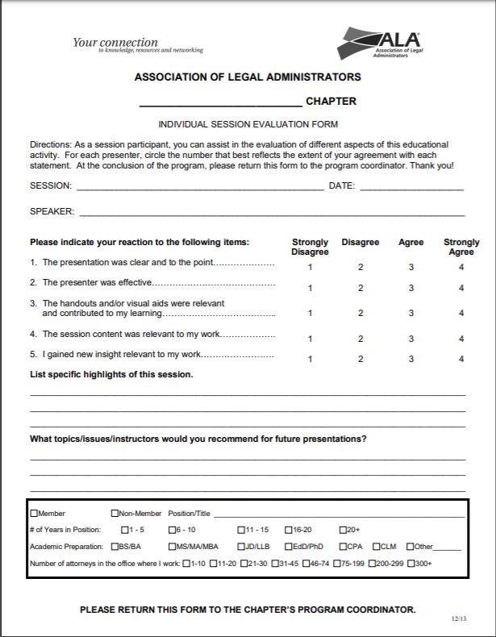
Evaluate
Notes:
Individual Session Evaluation Form - https://www.alanet.org/docs/default-source/chapter-resources/individual-session-evaluation-form.pdf?sfvrsn=920c52ab_0

Slide 10
CLM Study Group
Guide to Develop a CLM Study Group
How to Launch a CLM Study Group
Additional Resources
Chicago Study Group
Contact Chicago Chapter’s CLM Director
Rita Nielsen, CLM
Rita.Nielsen@lockelord.com
Notes:
Guide to Develop a CLM Study Group – https://www.alanet.org/membership/chapters/chapter-leader-resources/3e1b1f93-272c-6b26-8d51-ff000093711e
How to Launch a CLM Study Group - https://www.alanet.org/membership/chapters/chapter-leader-resources/301b1f93-272c-6b26-8d51-ff000093711e

Slide 11
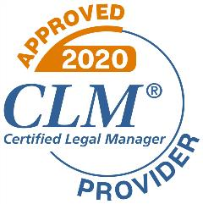
CLM Approved Provider Program
Opportunity to offer educational programs eligible for CLM credit for a one-year period without pre-approval from ALA national headquarters
Not a requirement
No cost
Completion allows usage of CLM Approved Provider badge
Notes:
CLM Approved Provider Program - https://www.alanet.org/education/clm-credit-approved-provider-program

Slide 12
Additional Approved Provider Programs
HRCI
Approved Provider (AP)
SHRM
Recertification Provider Program
Notes:
HRCI Approved Provider (AP) - https://www.hrci.org/get-started
SHRM Recertification Provider Program - https://www.shrm.org/certification/for-organizations/recertification-providers/Pages/default.aspx

Slide 13
Roundtable Discussion

Slide 14
Thank You!
Kara M. Brostron, CLM Gateway Chapter
kmbrostron@lashlybaer.com
Direct: 314-436-8366
Patti Winter, CLM, PHR, SHRM-CP Chicago Chapter
pwinter@fgppr.com
Direct: 312-863-5006
Reach a Chapter Resource Team Member at
chapters@alanet.org

